Slide 1
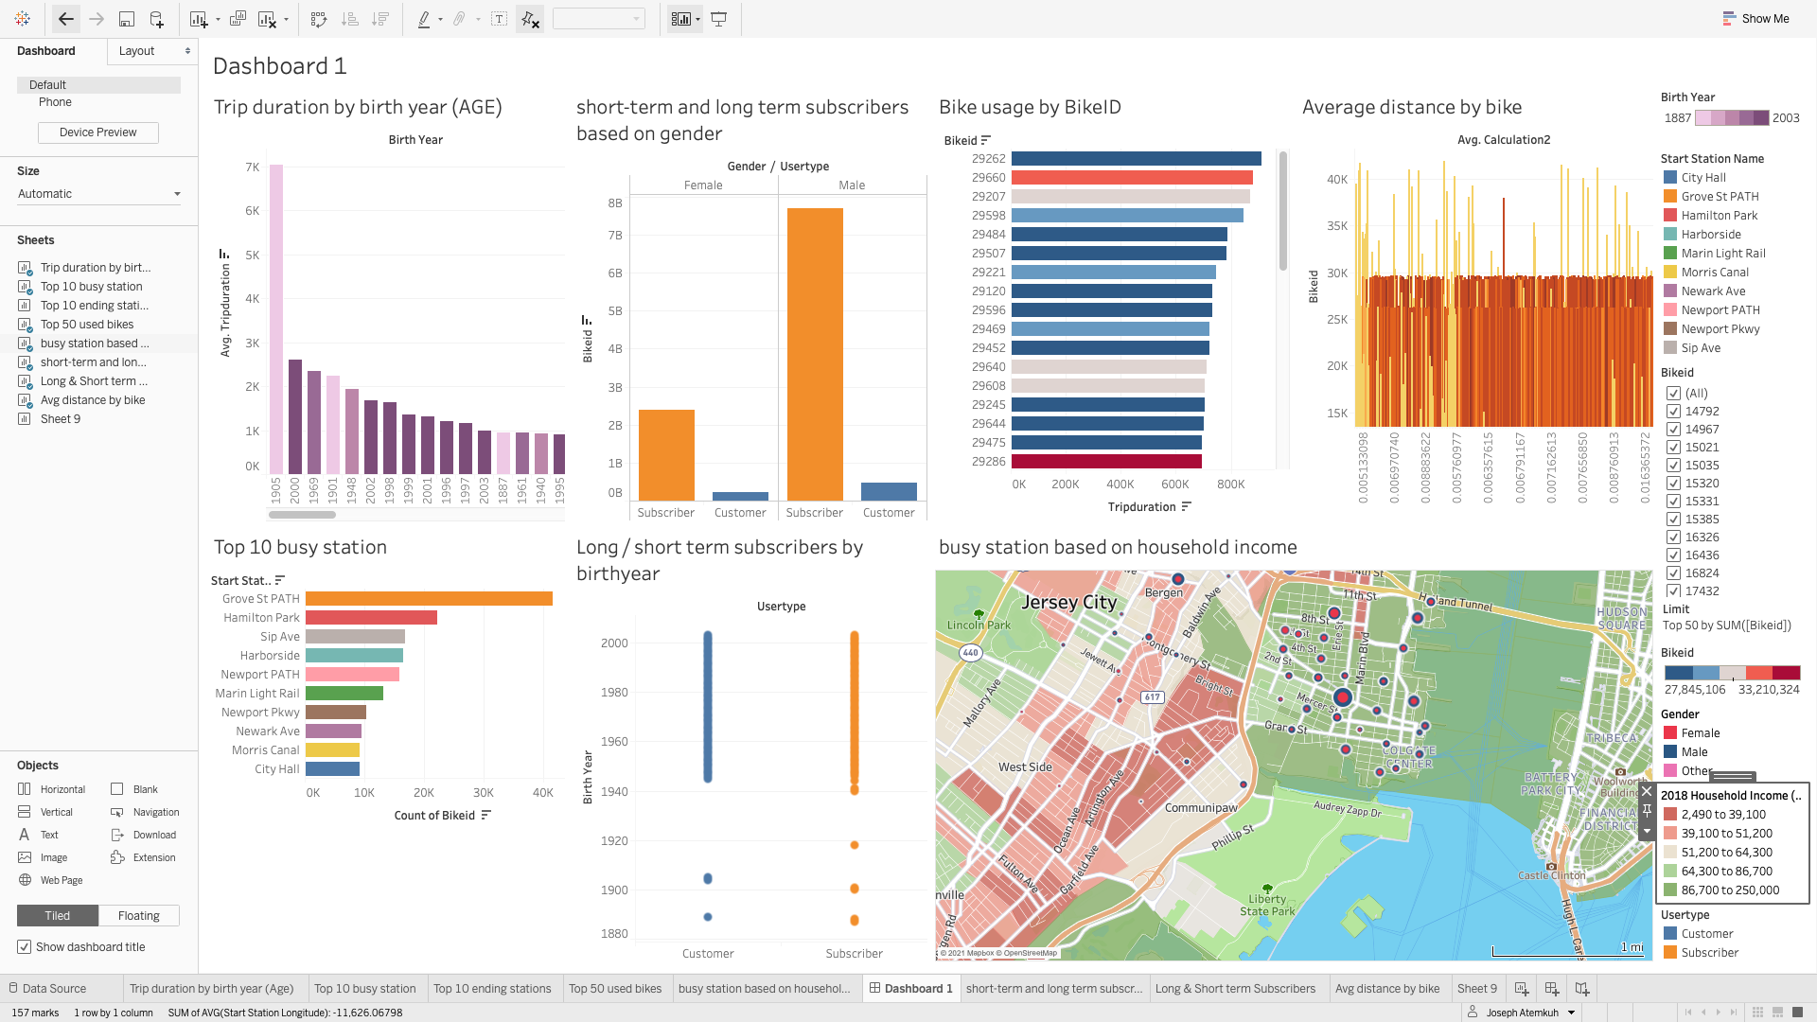
Jersey City 2019 Citi Bike Trip Data, Dashboard Visualization

Slide 2
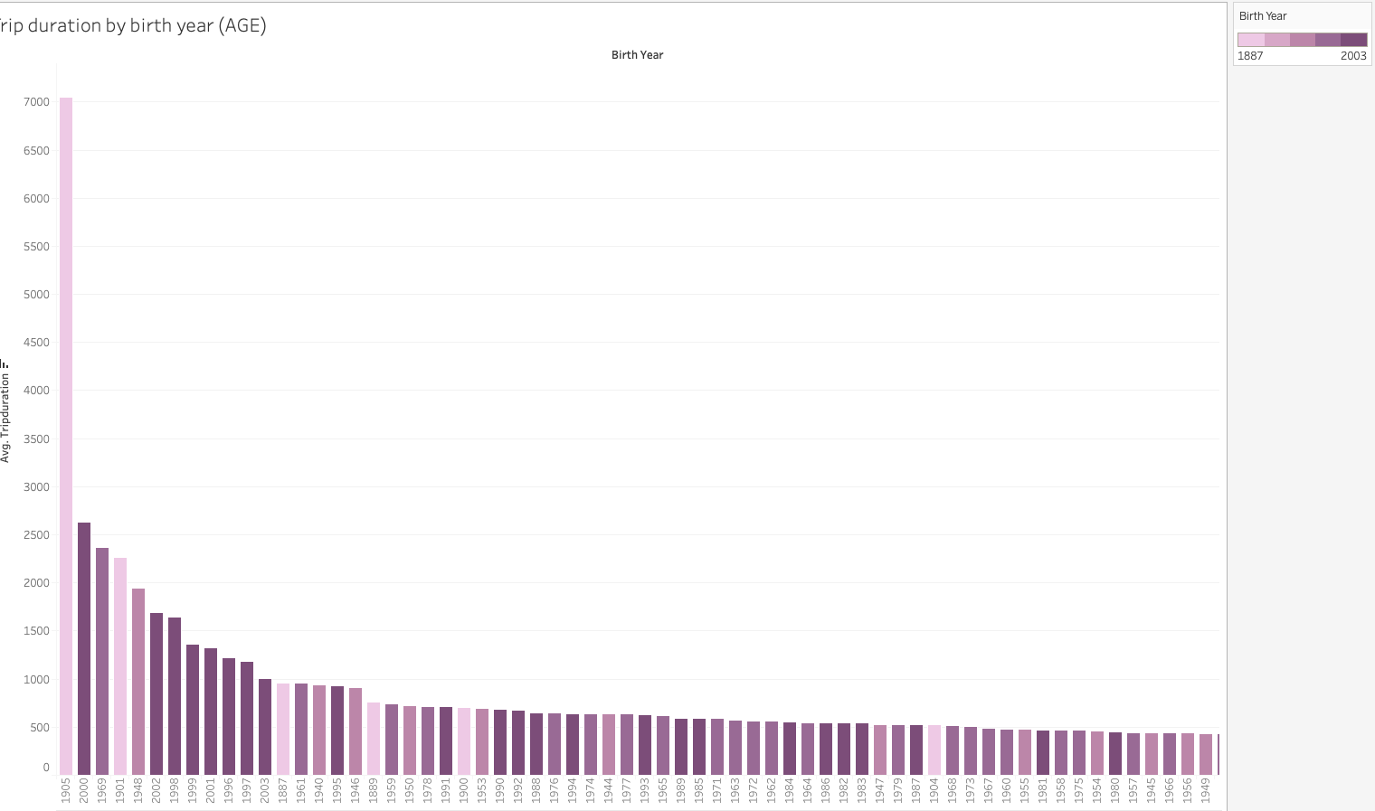
Trip duration by birth year (Age)
This graph represents average trip duration by birth year (age); this data can be use and an enabler for target marketing to specific age groups.
Note: you will notice that you have riders born between 1880 to 1960. My guess here is it could be that the riders choose not to enter their year of birth. My recommendation is CitiBike could make users enter their exact year of birth but capturing a picture of their identification documentation if they intend to use this data for target marketing.

Slide 3
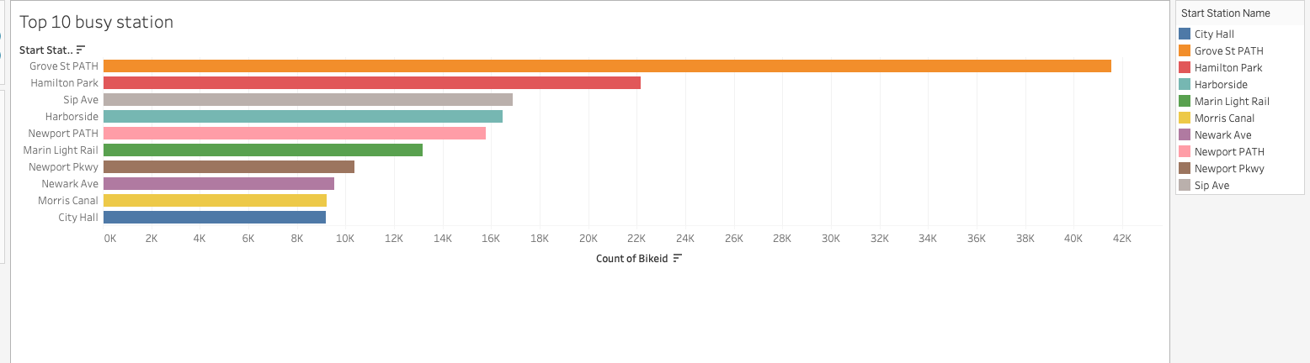
The Top 10 Busy Start Stations
People who work or live in and around these stations earn an income above the average income bracket; hence they could afford public transportation to and from work. However, they choose to use CitiBike for commuting as a means of physical exercise, a way to avoid heavy traffic to or from office to train station or their homes

Slide 4
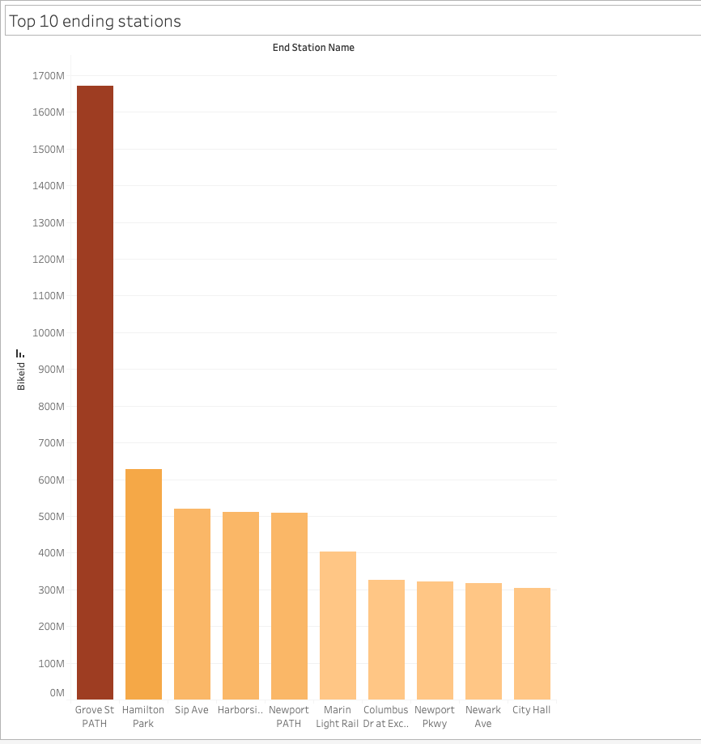
The Top 10 Busy Start Stations
People who work or live in and around these stations earn an income above the average income bracket; hence they could afford public transportation to and from work. However, they choose to use CitiBike for commuting as a means of physical exercise, a way to avoid heavy traffic to or from office to train station or their homes

Slide 5
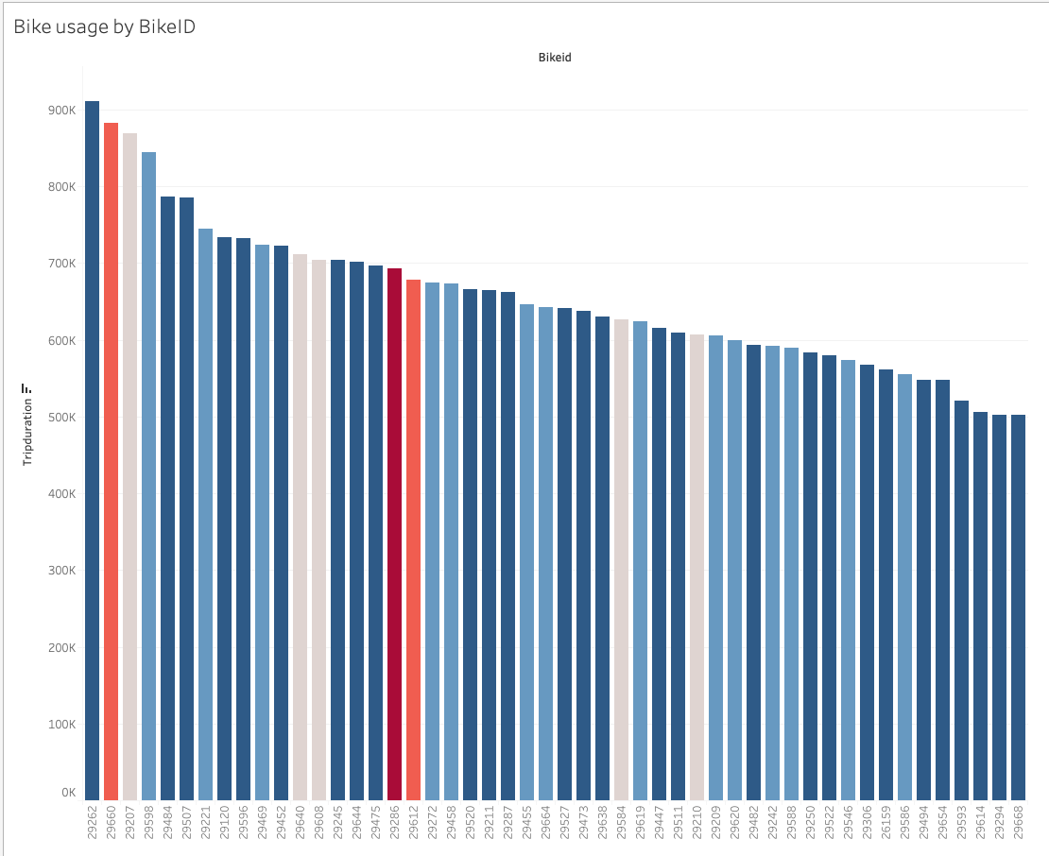
Trip duration covered by the most used bikes (50)
The essence of this analysis is to identify the most used bikes by trip duration covered, and this data will assist in planning for repairs and retiring of bikes.

Slide 6
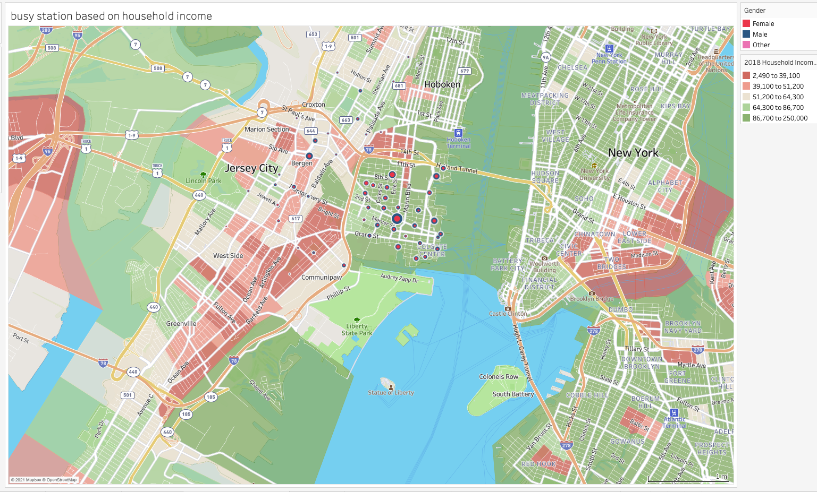
Busy stations by gender and household income
This visualization aims to base our facts on bike usage on gender and 2018 household income data.

Slide 7
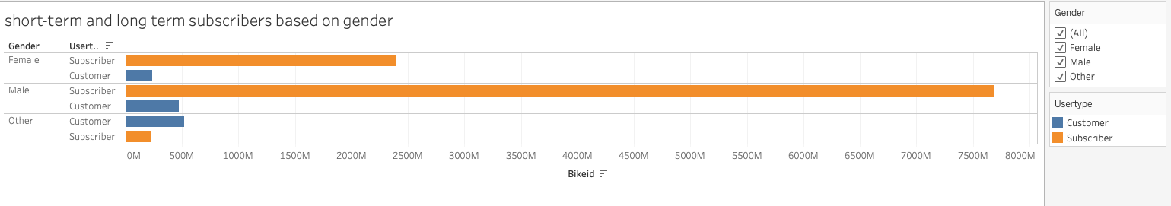

Slide 8
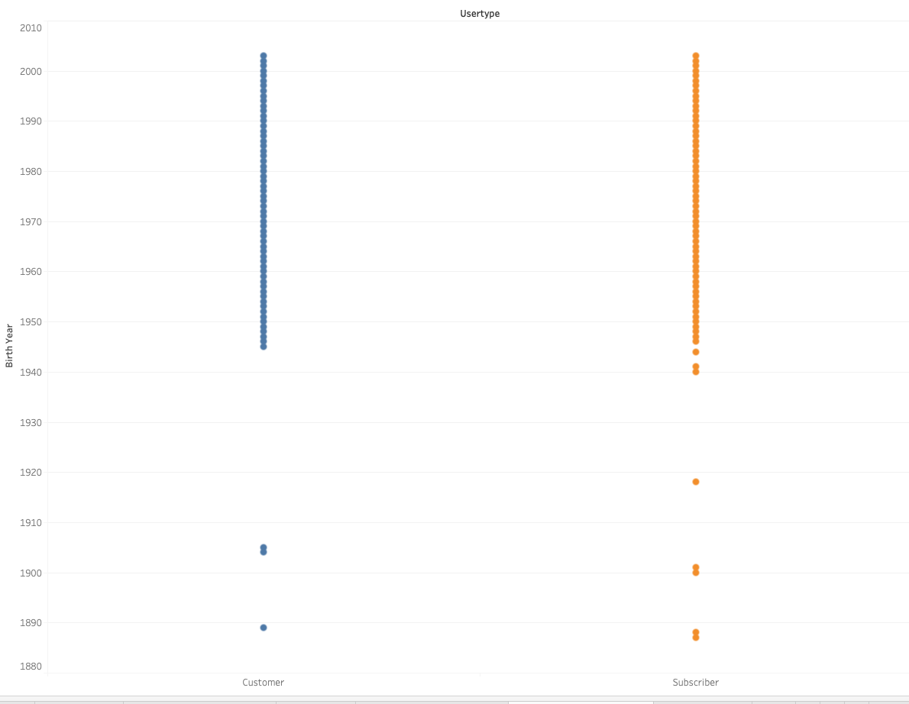
This graph represents usertype by birth year (age); this data can be use and an enabler for target marketing to specific age groups.
Note: you will notice that you have riders born between 1880 to 1960. My guess here is it could be that the riders choose not to enter their year of birth. My recommendation is CitiBike could make users enter their exact year of birth but capturing a picture of their identification documentation if they intend to use this data for target marketing.

Slide 9
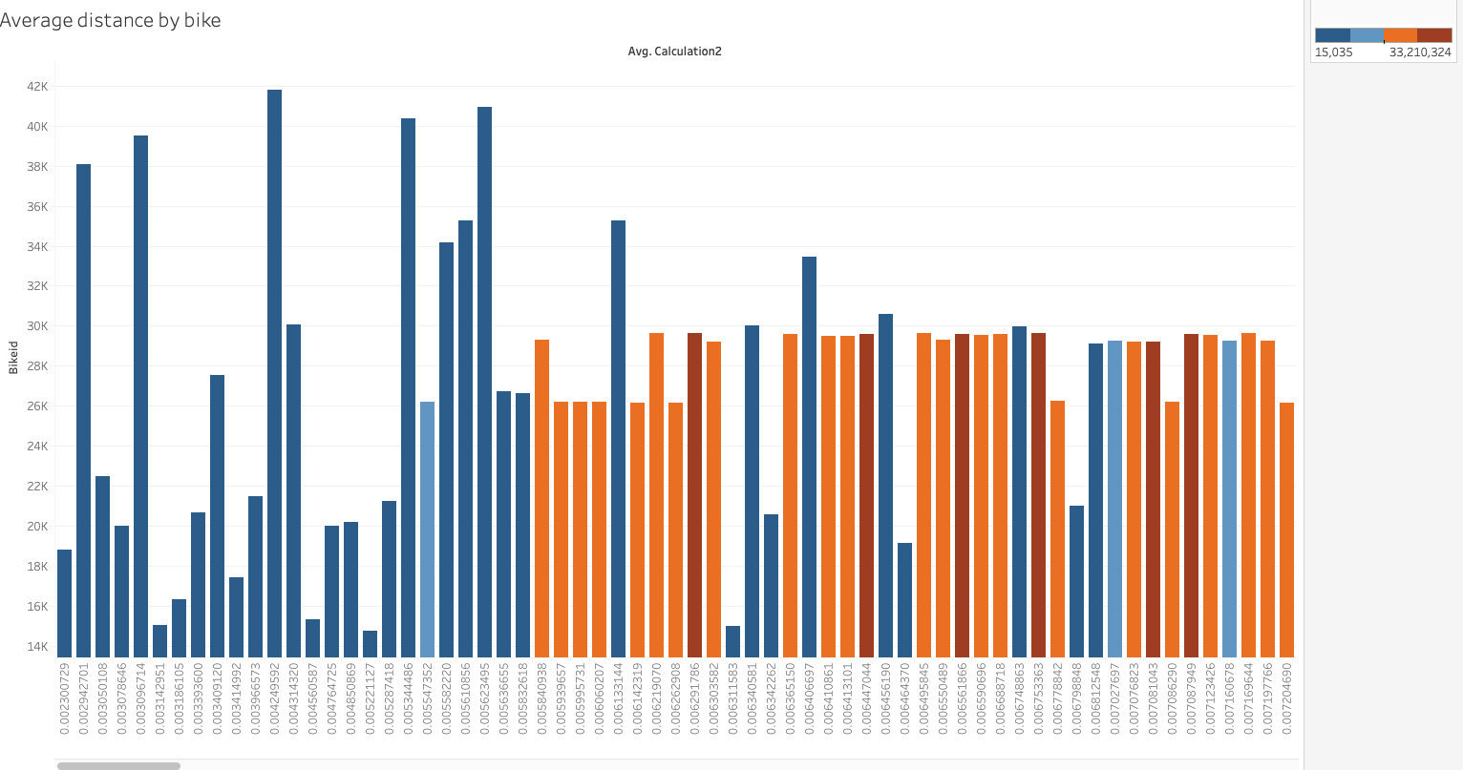
Avg distance by bike
This data again helps us to identify the average distance by bike,
this data will also assist in planning for repairs and retiring of bikes.

